Slide 1
PERS-43
Aviation LDO/CWO
Roadshow Brief
27 February 2025
RANK First Last
Office Title, Aviation Officer Distribution

Slide 2
AVIATION LDO/CWO
ASSIGNMENT BRANCH
CDR Michelle Higingbotham
Head Aviation LDO/CWO
Assignments PERS-434D
LCDR Doug Kesterson
Aviation LDO/CWO
Assignments PERS-434E
Ms. Melinda Weeden
LDO/CWO HR Assistant
PERS-434D/E

Slide 3
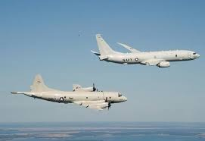

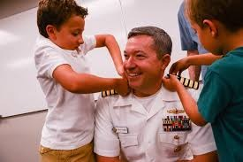
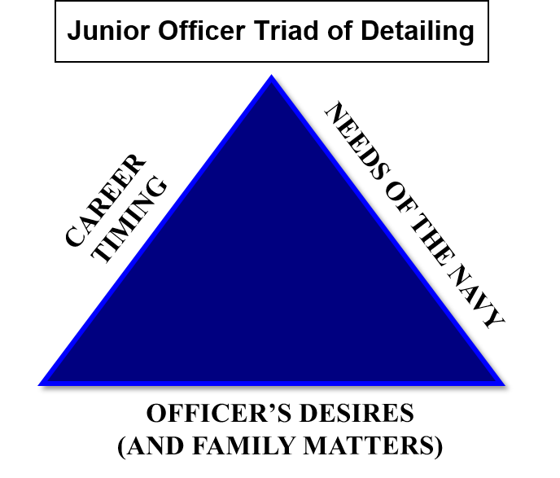
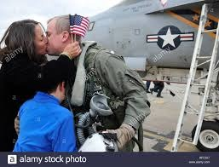

PERS- 43 Mission
Career Management
Match talent to task
Ensure constituents prepared for next milestone assignment
Respond to fleet needs
Facilitate Aviation Admin Boards
DETAILING TRIAD
  Building Strong Careers is our Job!

Slide 4
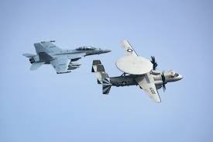
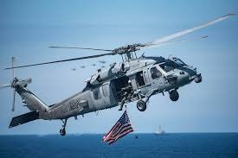
PERS-43 Organization
PERS-43
Director Aviation Officer Distribution Division
- 43A CAPT Detailer
- 43B Deputy Director
- 43C Director’s Assistant
PERS-431
CDR Assignment
PERS-432
LCDR/JO Assignments
PERS-433
Aviation Officer Placement
PERS-434
LDO/AMDOCWO/AEDO Assignments
PERS- 435
AvB/AviP
BUPERS3
Aviation Officer Community Manger
PERS-46C
Training and Admin of the Reserves
  Serving Over 14,000 Officers

Slide 5
Order Negotiations
Worldwide Assignability
Duty Preference Sheet
Orders
Pinnacle Tours and Timing

Slide 6
Order Negotiations
Worldwide Assignability
Factors in determining your assignment:
  1. Experience on Type Model Series aircraft. i.e. If you have F-18 experience you have a high probability of getting assigned to a VFA/VAQ squadron Overseas, Whidbey Island, Lemoore or Oceana. The next milestone applicable to your designator is also considered.
  2. Billet requirement/priority for LDO / CWO. i.e. Where do we need a 6XXX or 7XXX.
  3. Exceptional Family Member / Spouse Colocation Considerations
  4. Personal Preferences and available billets
  5. Assignments are based upon on requirements and may not be in the desired location of the member.

Slide 7
Order Negotiations
Duty Preferences
Review the Job Listing on NPC and email your duty preferences 12 months (CONUS) or 13 months (OCONUS/EFM/CO-LO) from your PRD. This starts your negotiation process. We will then dialogue via email or phone to determine your next job assignment. Use this format in email and send this along to your Detailer one month ahead of your negotiation window:
Subject Line: PRD YYMM, RANK NAME (LAST, FIRST)
Pinnacle Desires (LDO):
Current College Education:
Priority: (Location or Type Duty)
Geographical Location (i.e. Hampton Roads/Jax/San Diego)
1.
2.
3.
Type Duty (i.e. VFA/HSM/FRC/CVN)
1.
2.
3.
Submitting only one Geo Location or Type Duty limits your opportunity for orders and consideration for secondary and other excellent opportunities.
NOTES: Spouse CO-LO / EFM / Any other relevant notes.

Slide 8
Order Negotiations
JAX/Mayport Billet Base
JAX / MAYPORT | TAC
DESIG | CONUS SEA | Grand Total
6310 | 1 | 1
7311 | 1 | 1
Grand Total | 2 | 2
JAX / MAYPORT | TAC
DESIG | CONUS SEA | CONUS SHORE | Grand Total
6320 | 6 | 4 | 10
7321 | 11 | 7 | 18
Grand Total | 17 | 11 | 28
JAX / MAYPORT | TAC
DESIG | CONUS SEA | CONUS SHORE | Grand Total
6330 | 15 | 20 | 34
7331 | 18 | 9 | 27
Grand Total | 33 | 29 | 61
JAX / MAYPORT | TAC
DESIG | CONUS SEA | CONUS SHORE | Grand Total
6360 | 2 | 2 | 4
7361 | 11 | 9 | 20
Grand Total | 13 | 11 | 24
JAX / MAYPORT | TAC
DESIG | CONUS SEA | CONUS SHORE | Grand Total
6390 | 1 | 3 | 4
Grand Total | 1 | 3 | 4
Out of
1200+
There are very few billets in the Jax/Mayport area.

Slide 9
Order Negotiations
Orders
Nine months prior to your PRD your orders will be put in the system and it takes roughly one month to get them through the routing process. Delays will occur if your EFM is expired, any Time On Station (TOS) or Prescribed Sea Tour (PST) waivers will be addressed during the routing process.
Once routing is complete your orders will be held at “cost review” awaiting funding. Orders will be prioritized, funded and released by PERS-454. Fiscal constraints and continuing resolutions have an impact on release posture! Detailers do not manage or control order release!
Shore duty orders are written for 36 months to comply with MILPERS. PERS-4 may authorize the transfer of members earlier from shore duty to support overseas, sea duty, or pinnacle tours. Expect specific verbiage in your orders stating such.
Currently, newly proposed orders are being released through May 2025 CONUS / OCONUS. Order processing time changes with available funding.

Slide 10
Order Negotiations
Pinnacle Tour
TIMING AND PROCESS
Typically, a year after being pinned to LCDR you will be heading to your Pinnacle tour. This allows you to be in your Pinnacle tour for years 2, 3, and 4 as a LCDR, then transfer to your post pinnacle assignment and selection to CDR.
LCDR PRDs have little to do with transfer to there Pinnacle assignment. You may transfer up to a year early to get to this milestone tour.
When Pinnacle assignments become available, they will be offered based on LCDR(s) seniority.
The type of Pinnacle tour you desire and location may not be available. To stay competitive you must take advantage of the opportunities available to you.
The importance of this tour cannot be overstated! Think 2-3 tours out and do not make career altering decisions based on temporary life events. Please phone to discuss options.

Slide 11
Order Negotiations
Pinnacle Tour (cont.)
Your FITREPs and record will be reviewed before you are offered a Pinnacle assignment. We will review your record to ensure you have met the prerequisites for assignments. Such as:
CAGMO – Fixed wing experience required. Rotary wing
recommended. (Nominative – CAG/DCAG select).
L Class MO – FRC/AIMD recommended.
IM1 – FRC/AIMD recommended.
Handler – FDO tour recommended.
OHO – G-3 or CAG Gunner recommended.
L Class Gun Boss – L Class OHO or CVN DIVO recommended.
CSG Staff – MTOC and TAO required.
Major Approach Control – CVN or L Class required.
CAGMO tours are typically 24 months. All other pinnacles are 30-36 months to balance community inventory, FITREP competition and command continuity.

Slide 12
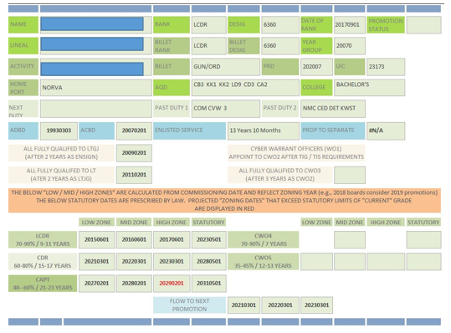
Promotion Zone Forecasting
LDO/CWO Officer Community Management team can “estimate” your promotion zones after the zone message is released.
LDO/CWO OCM points of contact: ldocwoocm.fct@navy.mil

Slide 13
Understanding The Zone Message
Typically, a NAVADMIN message setting the “zones” is released mid December each year. This message establishes the personnel and lineal number that are Senior in zone, Junior in zone and Junior eligible for each grade and competitive category for the upcoming year. The Junior eligible marks the end of the zone. FY-26 zone message, NAVADMIN 248/24.
Each officer has a unique lineal number. If your lineal number falls between the Senior in zone and the Junior in zone you are considered “in zone” for promotion. If your lineal number falls between the Junior in zone and Junior eligible you will be considered “below zone” for promotion. Please note, the more senior you are the lower your number. Examples:
Limited Duty Officer (Aviation) (63XX)
Senior in-zone - CDR D. D. Smith Jr 025683-25 1 OCT 2020
Junior in-zone - CDR U.S. Anderson Jr 025814-50 1 SEP 2021
Junior eligible - CDR R. C. Anderson 025847-00 1 SEP 2021
Example 1: If your lineal number is 025713-00 you fall between 025683-25 and 025847-00 thus considered in zone for promotion.
Limited Duty Officer (Aviation) (63XX)
Senior in-zone - LCDR D. E. Phelps III 047265-50 1 OCT 2020
Junior in-zone - LCDR I. M. Kamiss 047616-00 1 AUG 2021
Junior eligible - LCDR K. C. Nazaire 047725-50 1 SEP 2021

Slide 14
Understanding The Zone Message Finding
Your Lineal (Precedence) Number
Your lineal (precedence) number can change in your career. To find out your current lineal number (precedence) please refer to your Officer Data Card on BUPERS Online:
NOTE: Lineal numbers are based off of grade and Date of Rank (DOR), so when you promote, your lineal number will change for that new grade and DOR. SECNAVINST 1427.2A is the policy for lineal numbers.
Details can be viewed at:
https://www.bol.navy.mil
HERE IS YOUR LINEAL (PRECEDENCE) NUMBER
LINEAL NUMBER
1. SSN | 2. NAME | 3. SEX | 4. DESIG | 5. GRADE | 6. YRG | 7. PREC. NO | 8. BIRTHDATE
XXX-XXX-XXXX | JOE UNDERWAY | MALE | 63XX | LCDR | 7 | L 03868150

Slide 15
Active Duty Promotion Brief
Review the Active Duty Officer Promotion Brief if you are being considered for promotion this fiscal year.
Also search “MyNavy HR promotion videos” for detailed information on selection board processes and what happens behind the scenes.
NOTE: Board membership will no longer be published until after a board adjourned.
Details can be viewed at:
https://www.mynavyhr.navy.mil/Portals/55/Boards/Active%20Duty%20Officer/documents/Active%20Promotion%20Brief.pdf

Slide 16
LDO Community Brief
A community brief will be generated by the community leaders, including detailers and community managers. It will be vetted by Navy Personnel Command and OJAG for statutory compliance and approved by SECNAV.
Community leaders provide these slides to community members for career planning purposes; however, strict adherence to the career progressions depicted in the slides is not a prerequisite for promotion.
ONLY MATERIAL APPROVED BY THE SECRETARY OF THE NAVY WILL BE PRESENTED TO STATUTORY SELECTION BOARDS. THE BRIEF WILL BE APPROVED BY SECNAV FOR USE BY THE FY STATUTORY SELECTION BOARDS.
Briefs can be viewed at:
https://www.mynavyhr.navy.mil/Career-Management/Boards/Active-Duty-Officer/Community-Briefs/

Slide 17
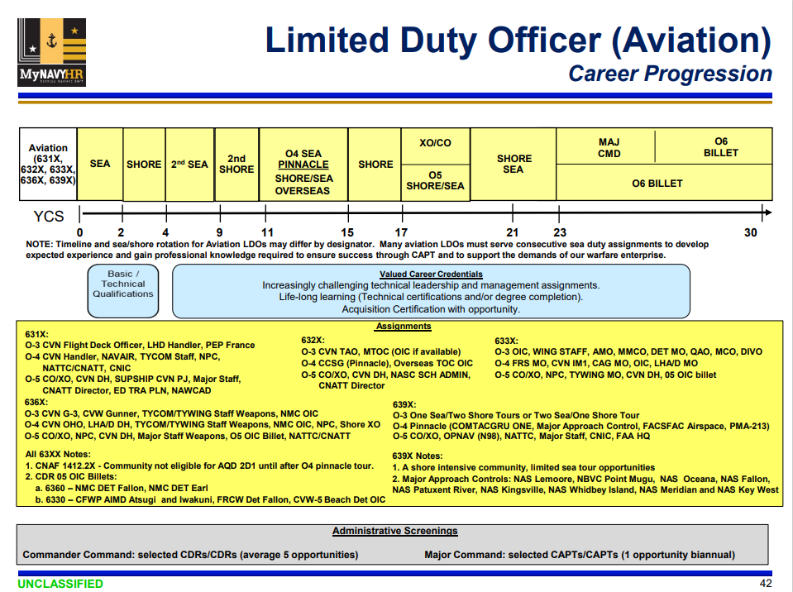
LDO Community Brief

Slide 18
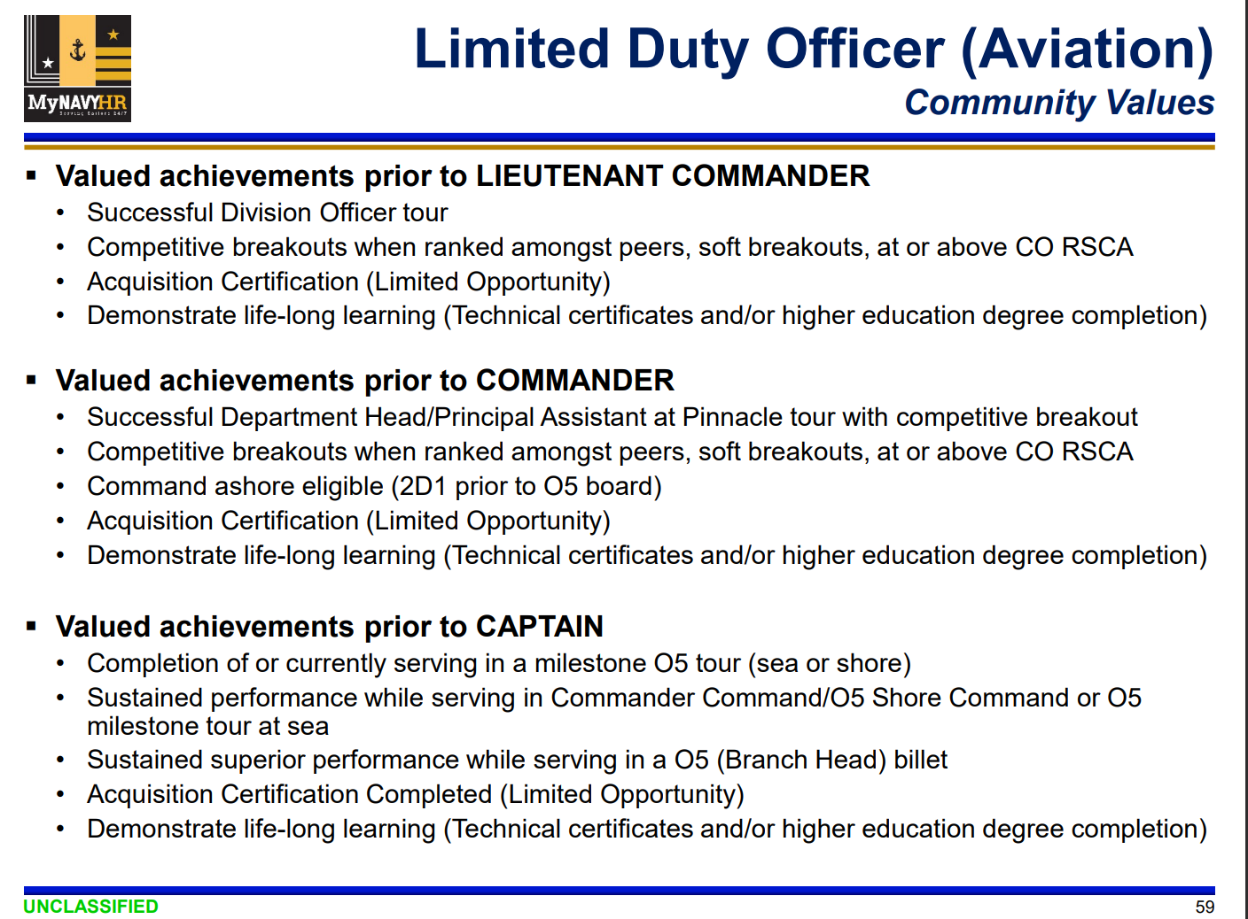
LDO Community Brief

Slide 19
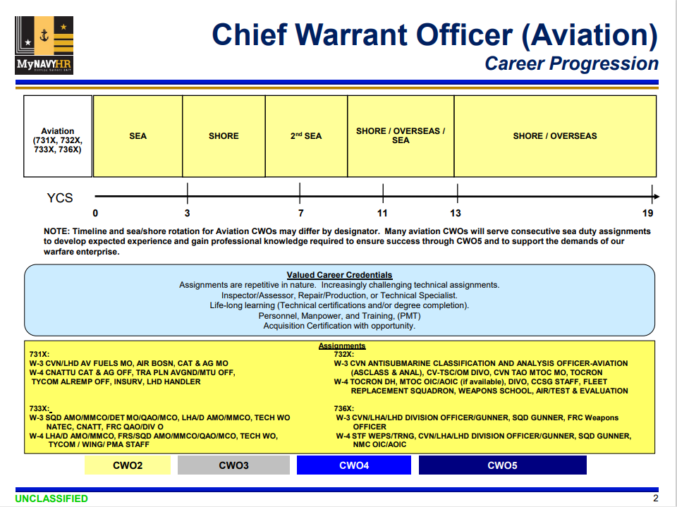
CWO Community Brief

Slide 20
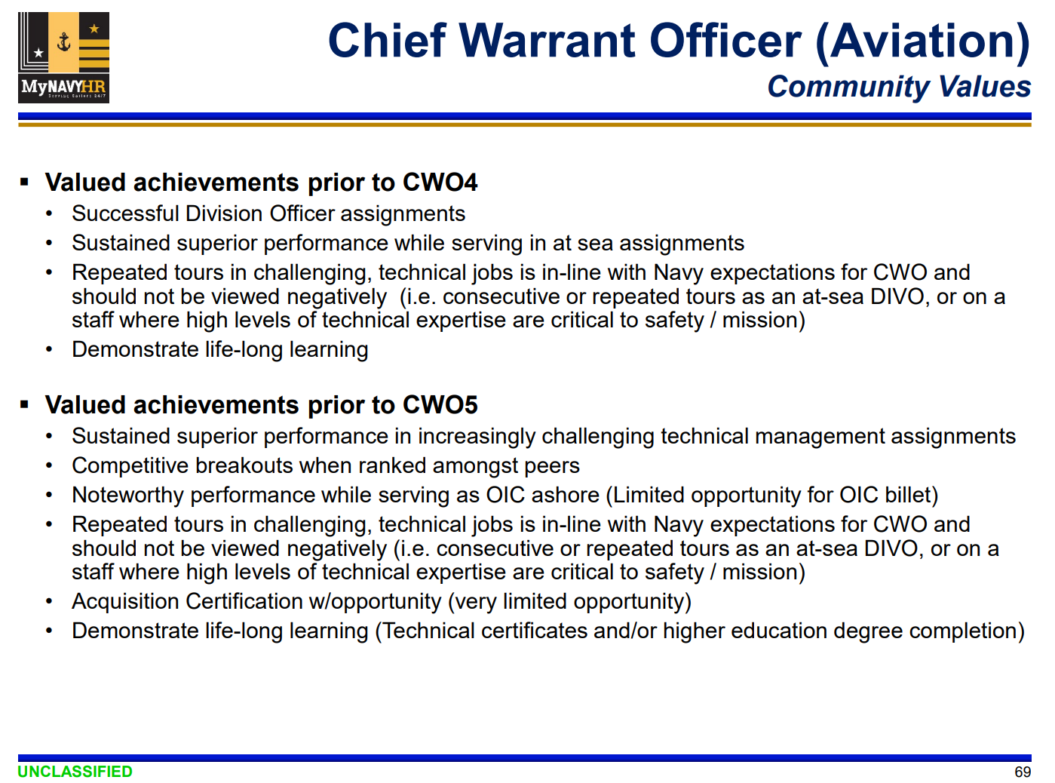
CWO Community Brief

Slide 21
Merit Reorder Brief
The Merit Reorder Values will be provided to assist board members in identifying performance and career achievements which may indicate a record of particular merit.
Board members are expected to use their experience and judgment after review of the records recommended for promotion to determine those records of particular merit.
Information on these slides are not an all inclusive list and should not be used to exclude records that otherwise document particular merit.
The information is not a checklist of traits required for merit and should not substitute for board’s discretion. It will be vetted by Navy Personnel Command and OJAG for statutory compliance and approved by SECNAV.
Briefs can be viewed at:
https://https://www.mynavyhr.navy.mil/Career-Management/Boards/Active-Duty-Officer/Community-Briefs/

Slide 22
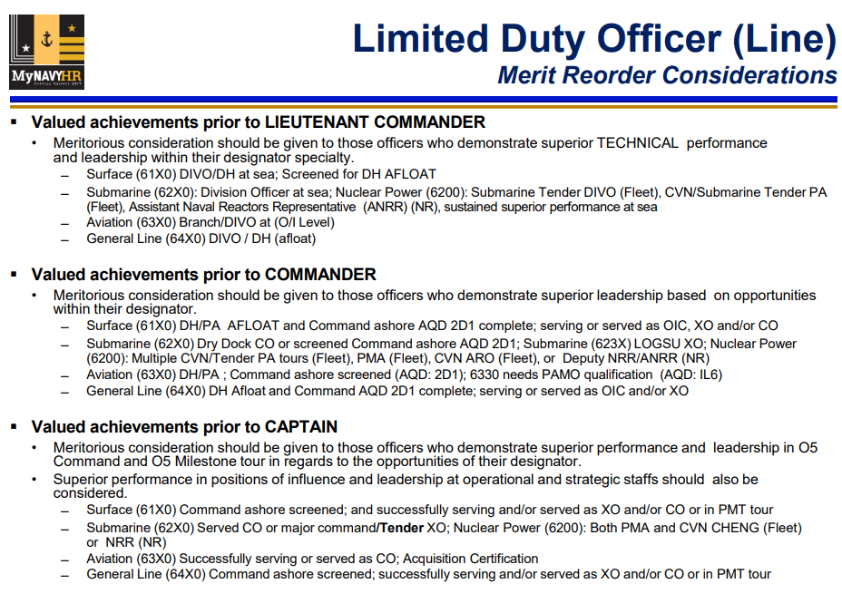
Merit Reorder Brief

Slide 23
Promotion Board Dates & Membership
CAPT (14 Jan 25)
We provide 1 Member (CAPT 63XX)
CDR (19 Feb 25)
We provide 1 Member (CAPT 63XX)
LCDR (19 May 25)
We provide 1 Member (CAPT/CDR 63XX) and 1 Recorder (LCDR/LT 63XX)
CWO 3/4/5 (09 Jun 25)
We provide 1 Member W5 73XX (preferred) or CAPT/CDR 63XX and 1 Recorder (CWO2-CWO4)

Slide 24
Selection Board Membership
We appreciate the number of personnel that continue to volunteer to support the Selection Board process. We are doing our best to give as many people a chance to participate in the process but understand we only have a few quotas each fiscal year. Additionally, some boards require previous board experience which also limits our selection pool. Please make your request for a specific fiscal year. Do not request participation for a specific board as this will disqualify you from participating in that board. FY-26 LDO/CWO Membership requirements:
Active//FTS/Reserve Aviation Major Command – (1) Member/O6/63XX
Active O-6 Line – (1) Member/O6/63XX
Active O-5 Line – (1) Member/O6/63XX
Active/Reserve LDO/CWO ISP - (1) President/O6/63XX (even year), (15) Members/O5/O4/W5/W4/63XX/73XX, (5) Asst Recorders/ O3/O2/W3/W2/63XX/73XX. May increase or decrease depending on number of applications received.
Active/Reserve/Aviation CDR CMD – (1) Member/O6/63XX
Active E-9 /E-8– (2) Member/O6/O6 sel//63XX
Active O-4 Line– (1) Member/O6/O5/63XX and (1) Asst Recorder /O4/O3/63XX
Active CWO-3/4/5 – (1) Member/W5 preferred, or O6/O5/73XX/63XX, (1) Asst Recorder /W4-W2/73XX
Active/Reserve E-7 – (2) Member O6//O5//63XX CWO5/CWO4, different designators based on # of eligible
Due course Officers receive first consideration.
  Have not declined pinnacle or other milestone tours.
No adverse matters pending
Passed most recent PFA (by instruction)
- On track for next milestone tour i.e. “Pack still on!”.
UPDATE YOUR NSIPS INFO:
Phone number and email
Demographic info

Slide 25
Promotion Board Approval Process
The goal is to have promotion board results released 100 days following adjournment of the promotion board.
Please see this link for more information on the promotion board approval process:
Details can be viewed at:
https://www.mynavyhr.navy.mil/Career-Management/Boards/General-Board-Info/Promotion-Board-Approval-Process/

Slide 26
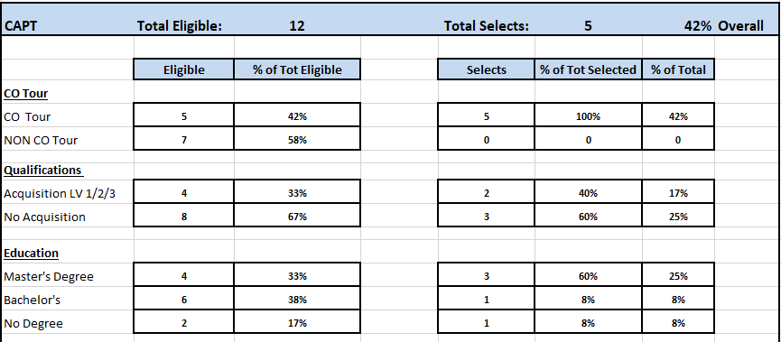
FY 25 CAPT Stats

Slide 27
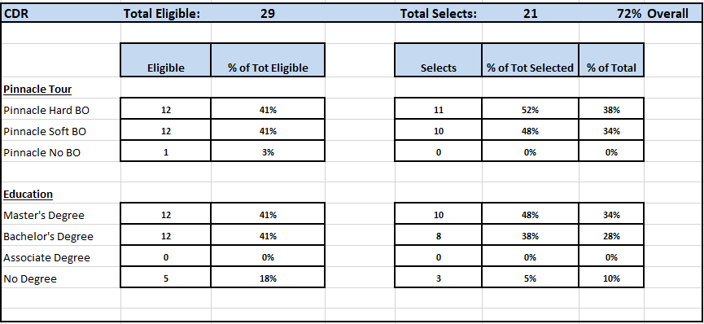
FY 25 CDR Stats

Slide 28
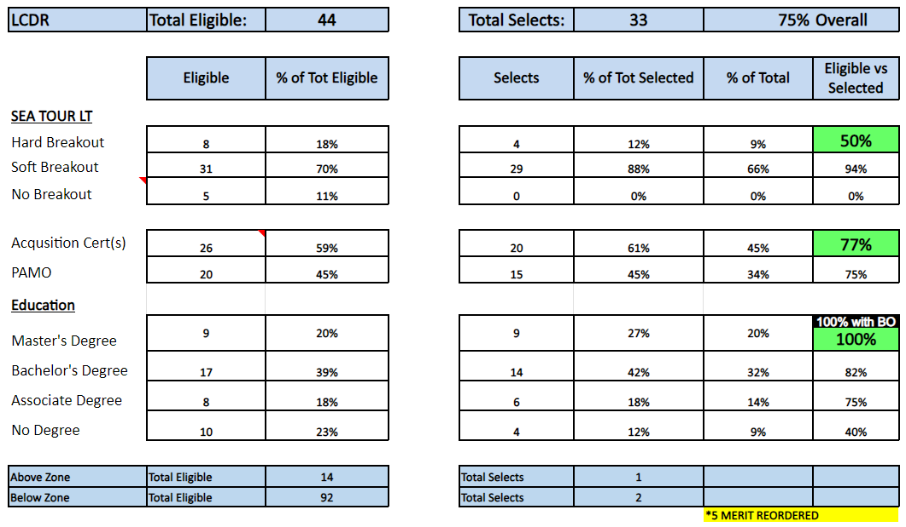
FY 25 LCDR Stats
Greater than 100% include Below and/or Above Zone

Slide 29
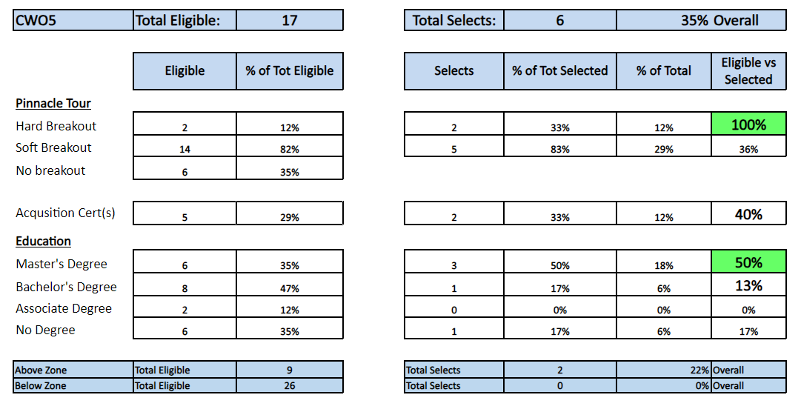
FY 25 CWO5 Stats

Slide 30
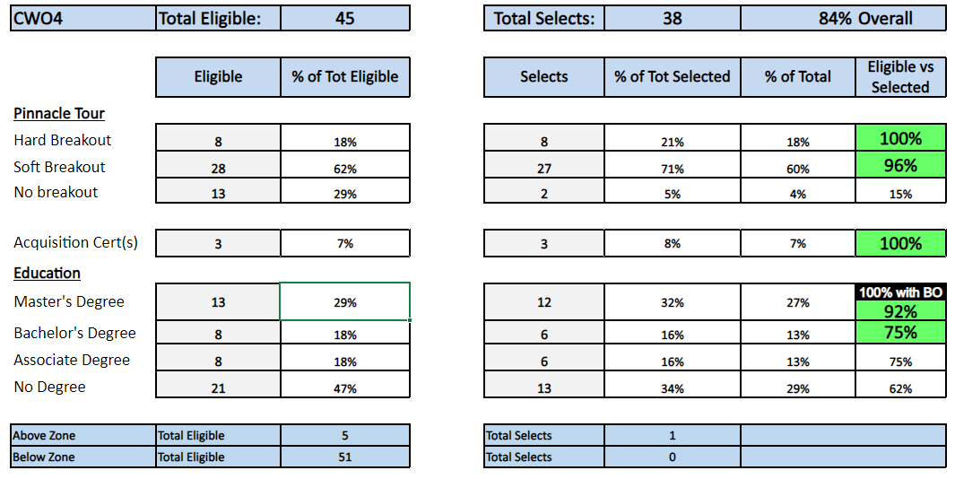
FY 25 CWO4 Stats
Greater than 100% include Below and/or Above Zone

Slide 31
Promotion Phasing Plan
When published the phasing plan for your grade and competitive category can be found at https://www.mynavyhr.navy.mil/Career-Management/Boards/Active-Duty-Officer/.
Once the phasing plan is released you can estimate the month your promotion should occur by following these directions.
While the phasing plan lists the number of promotes authorized per month it is not authorization for promotion. Authorization for promotion comes in the form of the NAVADMIN and only after an officer has been confirmed or approved.
The NAVADMIN authorizing your promotion for the first of the month should be available on the NPC website on approximately the 25th of the month prior to your promotion.

Slide 32
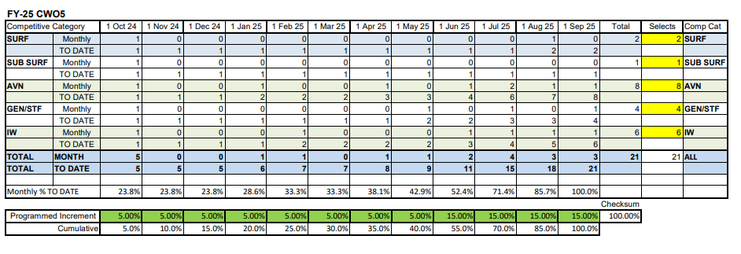
Example
Promotion Phasing Plan

Slide 33
One or Two Time
Failure of Select (FOS)
1 X FOS: Contact your Detailer if you desire a record review and counseling. You will remain at your current duty station pending the following year results.
2 X FOS: Your detailer will contact you to discuss retirement procedures. You will be required to retire NLT the1st day of the seventh month after FOS.
Example: Results approved by POTUS on 4 September. Your retirement day will be 1 April. (Month count: Oct #1st month, Nov #2nd, Dec #3rd, Jan #4th, Feb #5th, Mar #6th, Apr #7th)

Slide 34
Major Command/Command Screen Boards Information
Aviation Major Command Screen Board (AMCSB)
Aviation Command Screen Board (ACSB)
FY 25 ACSB LDO Stats
FY 24/25 ACSB Takeaways

Slide 35
Aviation Major Command Screen Board (AMCSB)
Must be an O6 or O6 select and have successfully completed a Commander Command tour.
Aviation LDOs compete at the Aviation Major Command Screen Board (AMCSB) for NATTC Commanding Officer billet typically every other year (even years).
If not selected for NATTC CO, or if NATTC CO is not in play, the Enterprise may allow waterfall into Special Missions Major Shore tank.
Special Mission (SM) assignments opportunities will not be known until the slating process begins after the board adjourns. SM commands typically include bases or facilities without active runway. SM commands may be located either CONUS or OCONUS based on the needs of the Navy.

Slide 36
Aviation Command
Screen Board (ACSB)
The ACSB board is held annually. All officers get three ACSB looks over a two year period.
The first look will typically be March of the following year of your O5 selection. Your record competes against all 63XX designators for operational command at available CNATTU and NAWMU-1.
If you don’t screen for Command on your first look, you will receive your second and third look the following year on the same board. Your record first goes into the 63XX tank for your second look at CNATTU and NAWMU-1, if available. If not selected in the 63XX tank, your record will waterfall into the Special Missions (SM) tank, which constitutes your third and final look. SM consideration will only apply when all community billets are adequately filled.

Slide 37
Aviation Command Screen Board (ACSB) cont.
Aviation Commander Command is highly competitive and critical for an LDO’s career progression!
What makes the difference:
  O-4 Pinnacle tour FITREP ranking
  Post Pinnacle tour assignment and performance
  Sustained Superior Performance throughout your entire record
  Evidence of Life Long Learning

Slide 38
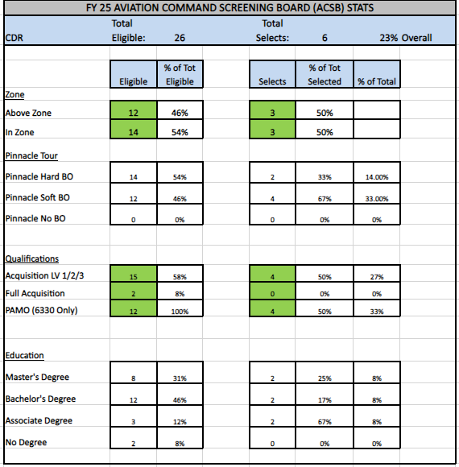
FY25 Aviation Command Screen Board (ACSB) LDO Stats
12 Above Zone
1 – 6310
0 – 6320
6 – 6330
3 – 6360
2 – 6390
14 In Zone
3 – 6310
0 – 6320
7 – 6330
3 – 6360
1 – 6390

Slide 39
Aviation Command Screen Board (ACSB) LDO Stats cont.
The #1 criteria for selection is sustained superior performance!
Your whole body of work matters!
                Takeaways
FY-24
Sustained superior performance with HBO / SBO.
Served in valued community jobs / consecutive hard tours.
FDNF tour were valued.
FY-25
Sustained superior performance with HBO / SBO through entire
body of work as a commissioned officer.
Multiple command recommendations.
PCS’d to take the hard and valuable community jobs.

Slide 40
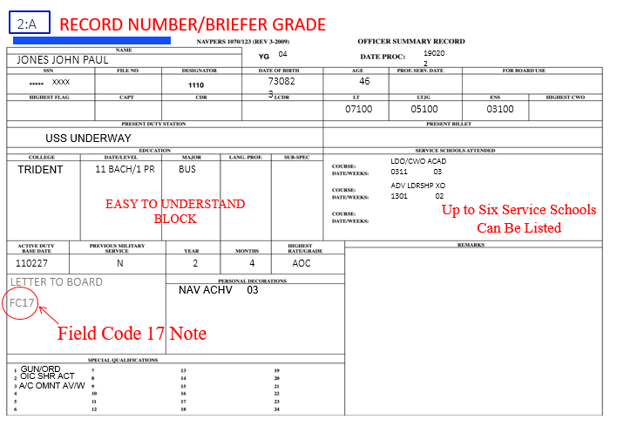

Understanding your OSR

Slide 41
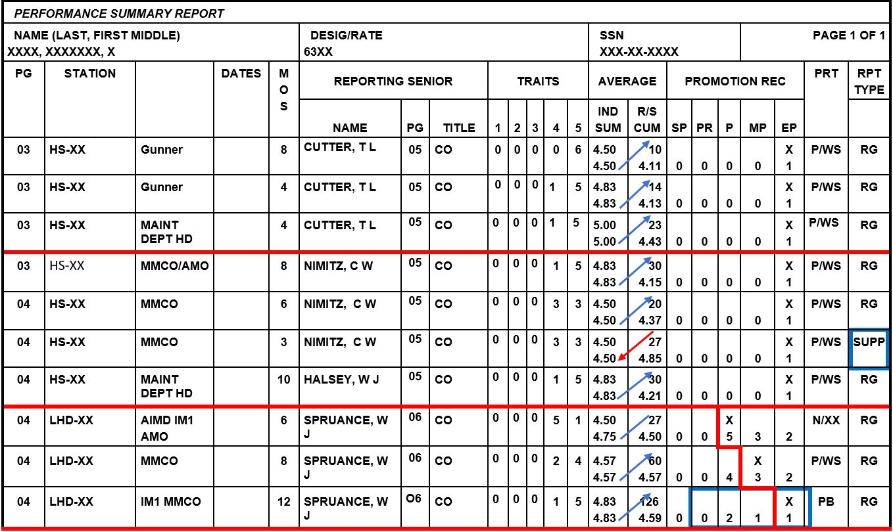
Understanding your PSR
A
B
C
D
E
A
D
Tracking well with all reports above RSCA
Report at RCSA, first report onboard
Progression, expected track to the right.
B
One reports below RSCA outside the OK Zone
E
C
SUPP = Supplemental letter to address/amplify the report
STUCK in TRAFFIC with no way out, talk to your command and detailer.
“OK Zone” – First report in the command or first report after being promoted. OK to be below RSCA.,

Slide 42
BOL FITREP - Continuity Report
                The continuity report feature serves as an audit trail on the status of your submitted FITREP. The status column will flow through the below steps as applicable. Purged or rejected are bad, the others are the process flow.
                What does Separated and Classified, Validated, Rejected, Uploaded, and Complete mean on the continuity report?
                Separated and Classified: Report has been received and pending examination.
                Validated: Report examined and pending acceptance to the Performance Summary Record (PSR) and permanent record.
                Rejected: Report not acceptable. Returned to reporting senior for correction.
                Uploaded: Report pending upload to PSR. **PLEASE NOTE: If report is in an UPLOADED status for over 7 working days, please contact MNCC Customer Service for assistance at 1-833-330-MNCC (1-833-330-6622).
                Complete: Report updated to PSR and permanent record.
                Purged: Report not acceptable. Returned to reporting senior for correction or Duplicate copy of previously received report.

Slide 43
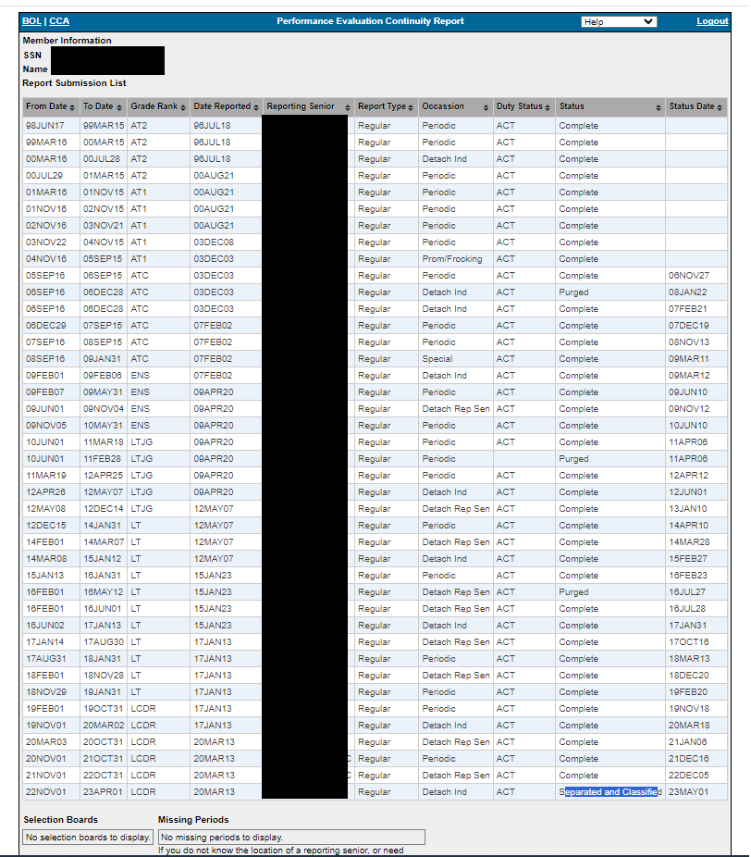
BOL FITREP - Continuity Report
Status of your
FITREP submissions
Audit Trail

Slide 44
Admin Change Request
RS FITREP Supplemental:
Adds information to an existing report.
** WARNING USE WITH CAUTION **

Slide 45
Missing Awards
Need Career, Pay or Personnel help?
Call MyNavy Career Center: 833.330.MNCC
How do I get an approved award certificate into my OMPF?
Note: PERS-312 is no longer the primary office for entering personal awards in NDAWS. Sailors are to work with their administrative support offices to have all valid awards entered into NDAWS.
Step 1 - Check to see that the award has been entered into the Navy Department Awards Web Service (NDAWS)
Step 2 - If the award(s) is/are reflecting accurately in BOL NDAWS but not in your OMPF, the administrative office may send a “quality”) .pdf scanned copy of the missing award to MILL_NavyAwards.fct@navy.mil and state in the email “This award is showing in BOL NDAWS but not in the OMPF”. PERS-312 staff will verify the award is correctly showing in BOL NDAWS and then have it manually scanned into the OMPF.
Step 3 - If the award(s) has/have not been entered into BOL NDAWS, contact your administrative office for assistance. It is their responsibility to update BOL NDAWS with your award in accordance with the NDAWS User’s Guide (Apr 2021).
Step 4 - Once an award has been submitted into BOL NDAWS, the application will create a digitally-signed 1650/3 and upload it along with the wet-signed certificate to the OMPF. DO NOT upload the locally-created, wet-signed 1650/3. This will create a duplicate in the OMPF.
If you are attached to a Joint/NATO/USMC command that does not have the ability to enter awards, PERS-312 can assist. The administrative office may send the award, scanned as a quality PDF, to PERS-312 at MILL_NavyAwards.fct@navy.mil. PERS-312 will not accept award submissions directly from the Sailor whose record is to be updated
https://www.mynavyhr.navy.mil/Career-Management/Records-Management/Decorations-and-Medals/

Slide 46
Frequent AQDS
Upon “COMPLETION” of the following certifications, qualifications or billet assignments email us your certification/qualification/FITREP and we will update your record with the appropriate AQD code. Please specify AQD code you are requesting and send supporting documentation to Mindy. Once AQDs are awarded, allow up to 72 hours for AQDs to show up on OSR
2C1 - GREEN BELT CERTIFIED
2C2 - BLACK BELT CERTIFIED
2D1 - COMMAND ELIGIBLE (Upon completion of oral board)
2D2 - COMMAND QUALIFIED (Upon completion of CO tour)
2D4 - MAJOR COMMAND (Upon selection for Major Command)
CAX - DIVISION OFFICER {ATCFO; MMCO; FLIGHT DECK; ORDNANCE OFFICER; CAT & ARREST; LAUNCH AND
RECOVERY; HANDLER; DIV O} (Upon completion of Division Officer Billet, not Branch Officer)
CBX - DEPARTMENT HEAD {MO; AIR OPS; READINESS OFFICER; WEAPON OFFICER; GUN BOSS; ADMIN OFFICER, DEPT HEAD}
CCX - EXECUTIVE OFFICER
CDX - OFFICER IN CHARGE
CEX - SHORE COMMAND
CFX - MAJOR SHORE COMMAND
DZP - TACMOBILE WATCH OFFICER
DZR - AVIONICS {36 MONTHS I-LEVEL EXPERIENCE ***7331 ONLY***}
H – SERIES – NAVY RECRUITING {CO; XO; OPS OFF; ASST OPS OFF; RECRUITER…}
IL1 - COMPLETION OF AMO LV1 SCHOOL AND INITIAL MAINTENANCE TOUR
IL2 - COMPLETION OF AMO LV2
IL6 - PAMO PQS
KK1 - EXPLOSIVE ORDNANCE MANAGEMENT – BASIC
KK2 - EXPLOSIVE ORDNANCE MANAGEMENT – OPERATIONAL
KK3 - EXPLOSIVE ORDNANCE MANAGEMENT – MASTER
LB1 - QUALIFIED OOD {INDEPENDENT STREAMING
LB3 - CDO UNDERWAY
LD9 - WEAPONS CONTROL QUALIFIED
LF6 - TAO – NON-NTDS
LF7 - TAO - NTDS
***** AQDS ARE NOT AWARDED FOR THE “ASSISTANT……” *****
Reference: https://www.mynavyhr.navy.mil/References/NOOCS-Manual/NOOCS-VOL-1/
Notes:
- Print your OSR – That is what the board sees
AQD Primary position - IL6 or 2D1 or 2D2.
Obtain the 2D1 in/or post LCDR pinnacle tour

Slide 47
Updating NOBCs
Details:
To update Navy Officer Billet Classification (NOBC) Codes, do the following: Submit email to MNCC l
Send email to askmncc.fct@navy.mil and list NOBC’s per the below.
In order to gain assistance with a NOBC update, please resubmit your requests in the following format:
  Assignment Dates: YYMMDD – YYMMDD (enter dates per your ODC)
  NOBC Title: (per the NOOCS Manual)
  NOBC: XXXX (four-digit number per NOOCS Manual)
  MOS: XX (per FITREPs)
  FITREPs to support request. Its helpful if the Officer will clearly identify the text or information from the FITREP that matches the NOOCS Manual.
Please be sure that the dates on your NOBC Request matches the dates on your FITREP(S), and are within the REPORT and LOSS dates on your History of Assignments in NSIPS.

Slide 48
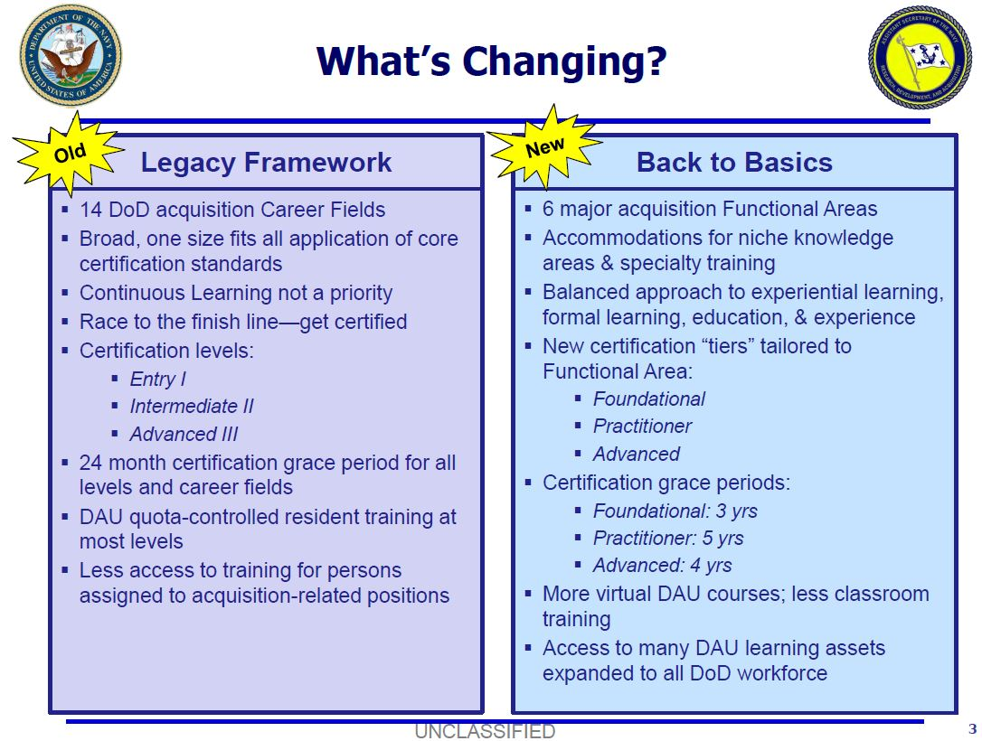
AQD Certification Changes

Slide 49
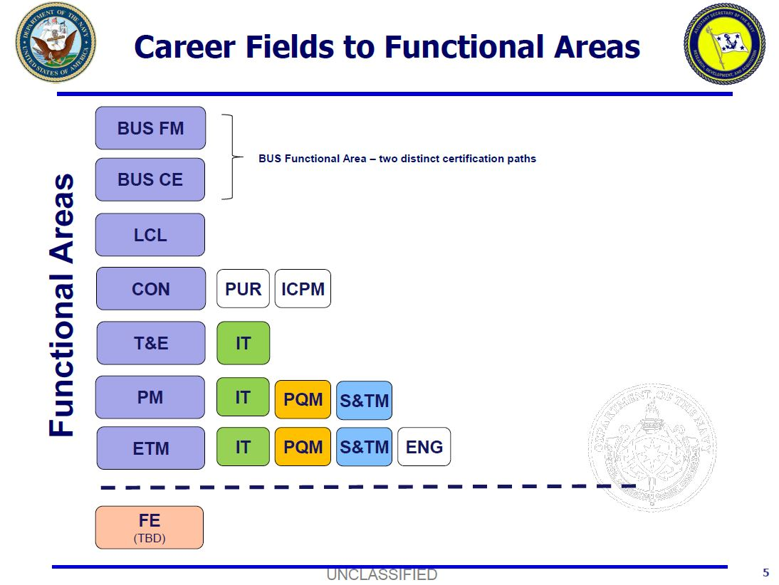
New Functional Areas

Slide 50
New Functional Areas (cont’d)
All account certifications did not transition to BtB.
  - Level I and II to Foundational
  - Level III to Advanced
Program Management Level I is obsolete. There is no conversion option.
If your transcript in eDACM only shows your legacy certifications and did not transition to BtB Functional Area Certification, submit a trouble ticket in eDACM requesting to have your legacy certifications converted.
The above process has been verified for some in acquisition coded billets.
If your legacy certifications have not transitioned, or you run into barriers because you are not in a coded billet, do not worry, legacy certifications and the associated AQDs are still in your record to do no harm.

Slide 51

50 percent credit toward AQD
How do I request 50 percent credit toward AQD certification?
Complete all certification requirements.
Submit a waiver request letter to DACM via the Detailer (sample letter next slide).
Recommendation letter from your COC.
Explain in detail the work performed in support of the AQD requested.
Enclose the applicable Position Category Description (PCD) for the AQD.
Enclose a copy of your DAWIA transcript to show proof of completed training.
Provide documented proof of work performed in the AQD field (Fitness Reports). FITREP bullets should match bullets provided in your letter. Remove/cover SSNs on FITREPs. The PCD defines what is acquisition work and language.
Email your complete package to Detailer at 43_1ldo-cwo_dtlr.fct@navy.mil in one single continuous PDF document.
The 50 percent credit will be examined when you submit your request for certification after you have completed all other education requirements and time. You will not see the time on your transcript, if approved you will be granted certification. Recommend phoning before proceeding. Process:
12 IPS
Elements
Sustainment work
Left a billet that is now acquisition coded? You may be able to request time!

Slide 52
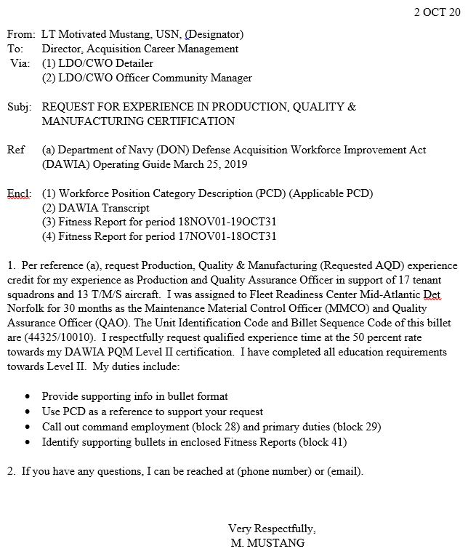
Sample AQD Letter
Subj: REQUEST FOR EXPERIENCE IN LIFE CYCLE LOGISTICS CERTIFICATION

Slide 53
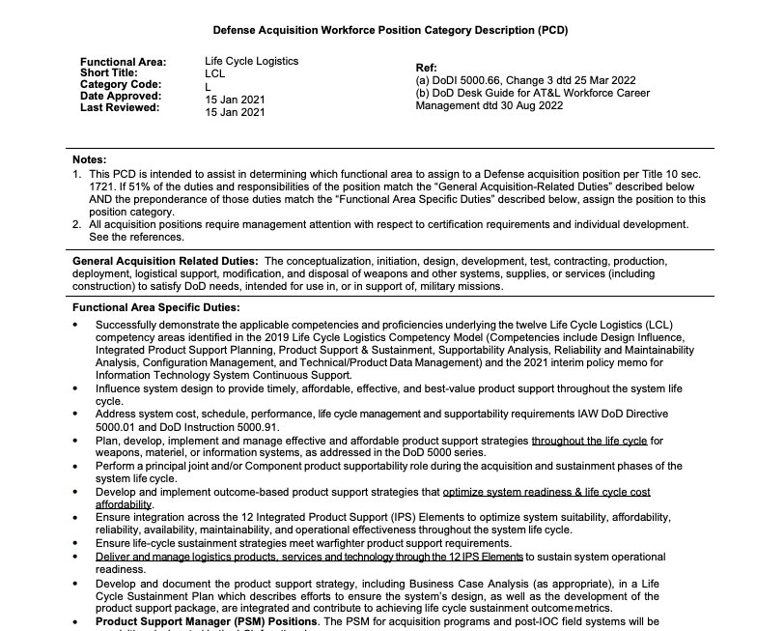
LCL PCD

Slide 54
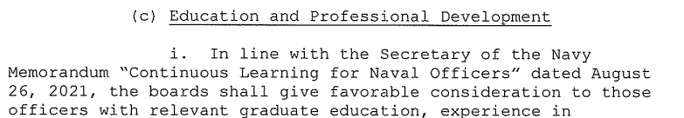
Education
Sustained superior performance is still the most important aspect of your career. However, education is important!
As you promote having a degree becomes more critical, start early.
Have a degree program established, and when the time allows, take a class.
Recommendation to be competitive with peers: Bachelor’s for LCDR board, Master’s for CWO5, CDR, ACSB, and O-6.
Convening order:
Proposed “Self driven….”

Slide 55
Education cont…
For new accessions, don’t expect your education to transfer from you enlisted record to your officer record. Official transcripts must be sent by the accredited organization, not the member.
If you haven’t completed your degree prior to your promotion board it’s recommended you submit a letter to the board president and attach a copy of your estimated graduation date from your college institution.
Additionally, if you have college credits but have not completed all degree requirements and are eligible for a promotion board it is recommended you request a transcript and have it sent for analysis. Your record could be annotated to reflect 2, 3, or 4 years of college which is better than having nothing annotated at all.
** Best practice ** Help them help you, in your email request to MNCC reference your exact education level and credits earned using Appendix D page 4-6 in NOOCS Volume II.
Example: ”Request my record of education achievement be added to my ODC per NOOC VOL II appendix D. Specifically, I request Level of Education Achievement code 2 per NOOCS page D-4 having achieved a minimum of 15 but less than 60 semester hours of credit in a degree program be added to my record.”

Slide 56
Education cont…
Transcript submission options:
Electronic Delivery
Officers must have their official transcripts emailed to askmncc.fct@navy.mil. Some institutions may send a notification via email when the document has been downloaded, however, please allow additional time for the transcripts to be processed.
** Transcripts sent electronically through National Student Clearinghouse must select
“Education Organization, Application Service and Scholarships”,
“Department of the Navy” and “Navy Personnel Command”
in the drop-down menus of the recipient details section.
Selecting other options may result in failure to deliver transcripts electronically. **
Standard Mail Delivery
Officers who already have their official transcript/certification in a sealed envelope may forward it to the following address below in its sealed status. If not, the member will need to have the awarding institution mail their sealed official transcripts to:
NAVY PERSONNEL COMMAND
MNCC
BLDG 768 RM E302
5720 INTEGRITY DRIVE
MILLINGTON, TN 38055
For questions regarding status of record update, please contact MNCC at askmncc@navy.mil or by phone at 1-833-330-6622.
https://www.mynavyhr.navy.mil/Career-Management/Education/Subspecialty/

Slide 57
General Guidance
General Information
Current Aviation LDO/CWO Billets to Bodies Inventory
Tentative Detailer Trips
Career To Do’s
PII
Exceptional Family Members (EFMs)

Slide 58
General Information
  We return all calls if you leave a voicemail with a callback number.
  Its very important to follow up all conversation with an email to the detailer. This provides a record of what has been discussed and a record of negotiations.
  In the event you do not receive a response to an email within a week, please retransmit email in case it was not received. Some research but will get you an answer.
  We detail to best support operations and to ensure you stay competitive for promotion.

Slide 59
Fiscal Year
Tentative Detailing Visits
1st Quarter:
Hampton Roads Visit: 18-22 November
2nd Quarter:
PERS-43 Japan site visit: 13-18 January
AVOPS Summit, Charleston SC: 12-15 March

Slide 60
Career To Do’s
Get Smart on Selection Board Processes and keep your record up to date.
Read the Board Precepts, Convening Orders, and watch the board videos!
Have a Plan! “Think” 2+ Tours Ahead as “Career Timing” promotes success. (12/13 month detailing window applies).
Utilize NAVPERS Blue Book and Career Pattern Sheets.
Good career management consists of education, flexibility, and communication w/family, mentors, leadership & your Detailer).
Have mentors on active duty, and at each level you aspire to achieve!
Decision gates: PRD, Promotions (especially making LCDR…Be ready to move), Retirement, Major Family Events, and Education.
Take the career enhancing tough jobs! Think you don’t have legs? There are 19 Aviation LDO CDRs serving today commissioned at 14 years or greater enlisted service.
Sustained superior performance is the key to operational and your professional success!

Slide 61
EFM Updates
EFM updates are required every 3 years.
Orders will not be processed through the system if EFM is out of date.
Effective October 1, 2024, EFMP categories will be dissolved to create a more personalized approach to assignments.
Detailers consult with EFM policy on all EFM orders. More often than not the decision is based on the availability of care in the new area. Continuity of care is also considered.

Slide 62
Retirement
Retirement Questions
Retirement Information
Service Obligation Requirements
Retirements, Promotion Opportunity and NSIPS

Slide 63
Retirement Questions
Retirement Questions:
Please refer to the Retirements FAQ page:
https://www.mynavyhr.navy.mil/Career-Management/Retirement/Officer-Retirements/FAQs/
Retirement request: NAVADMIN 273/17, announces a self-service function for Retirements and Separations (RnS) within Navy Standard Integrated Personnel System (NSIPS). This functionality allows members to initiate requests electronically via NSIPS self-service, route them through their chain of command for review and recommendation, and then electronically route the request to Navy Personnel Command for a decision.
When will I get my retirement orders?
NLT 5 months before the retirement date.

Slide 64
Retirement Information
Please notify your detailer 15 months prior to statutory or voluntary retirement. This will ensure command readiness and manning is maintained in planning your backfill. Retirement request is submitted via NSIPS. Please follow the guidance in MILPERSMAN 1810-020 and NAVADMIN 273/17:
Statutory Calculation:
LDO: 30 yrs (O4) / 35 yrs (O5) / 38 yrs (O6)
rounded to the 1st of the following month plus an additional month.
CWO: 30 yrs (CWO4) / 33 yrs (CWO5) plus 2 months and 1 day.
rounded to the 1st of the following month plus two additional months.

Slide 65
Stat Retirement and NSIPS
Five months prior to your statutory retirement date you will receive a system generated letter from PERS-8 with your effective retirement date. If you plan to retire on this date no further action is required in NSIPS. If you decide to retire earlier than your effective retirement date, you will need to log into NSIPS and navigate to Retirements and Separations to request a new retirement date.
If you are eligible for promotion during this timeframe, receipt of statutory retirement letter will not affect your promotion opportunity.
If you are selected for promotion and the statutory retirement date of your old paygrade is before your promotion date, please email Retirements (PERS-835) and let them know you intent to accept promotion and to cancel the processing of your statutory retirement.

Slide 66
Obligated Service Requirements
NAVADMIN 288/17: EARLY SEPARATION POLICY
“Retention of every capable Sailor will be critical to the operational
readiness of the Navy. Therefore all early out programs and minimum service requirement waiver programs are cancelled. Service commitments such as enlistment contracts, service obligations for accepting promotions, bonuses, education, etc., are expected to be fulfilled”
Tuition Assistance incurs a TWO year obligation.
LCDR TIG requirement changed from TWO to THREE years.
Transfer of Post 9/11 Education benefits incurs a FOUR year obligation.
Retirements details MyNavy HR https://www.mynavyhr.navy.mil/Career-Management/Retirement/Officer-Retirements/Officer-Retirement-Laws/

Slide 67
Questions

